Slide 1

Effect Of Internet Addiction On Sleep Quality
Ann Mathew
2348010
2MDS

Slide 2
INTRODUCTION
Internet addiction is a mental condition characterized by excessive use of internet. It is mostly observed in teens.
This unrestrained use of the internet results in many physical and psychological problems.
Sleep is necessary for the proper functioning of our body, but it is compromised due to our busy schedules and thus affects us adversely. Insufficient sleep and poor sleep quality may result in poor memory and weakened learning abilities
It is found that spending ample time on internet is associated with poor sleep quality.
Frequent late-night internet use disrupts the body's natural sleep-wake cycle (circadian rhythm). The blue light emitted from screens suppresses melatonin production, a hormone crucial for sleep initiation and regulation.
Engaging with stimulating online content, like playing games or watching videos, activates the brain's reward system and increases alertness. This heightened state makes it harder to switch off and transition into sleep.
Studies show that sleep quality of students with internet addiction is worse than that of students with normal internet usage.
Thus the effect of internet addiction on sleep quality is to be determined.

Slide 3
TABLE OF CONTENTS
01
02
03
OBJECTIVES
METHODOLOGY
ANALYSIS
04
05
06
CONCLUSION
FUTURE PROSPECTS
SUGGESTIONS

Slide 4
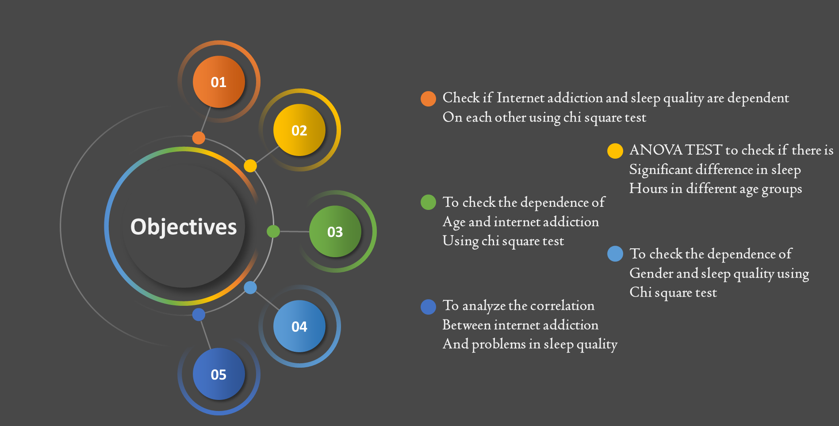

Slide 5
LINK TO GOOGLE FORM
https://docs.google.com/forms/d/e/1FAIpQLSc6dMuvsHexoAwGPhDohQWch3tC2b9KhXLVzWp47_Wb2D8Fug/viewform?usp=sf_link

Slide 6
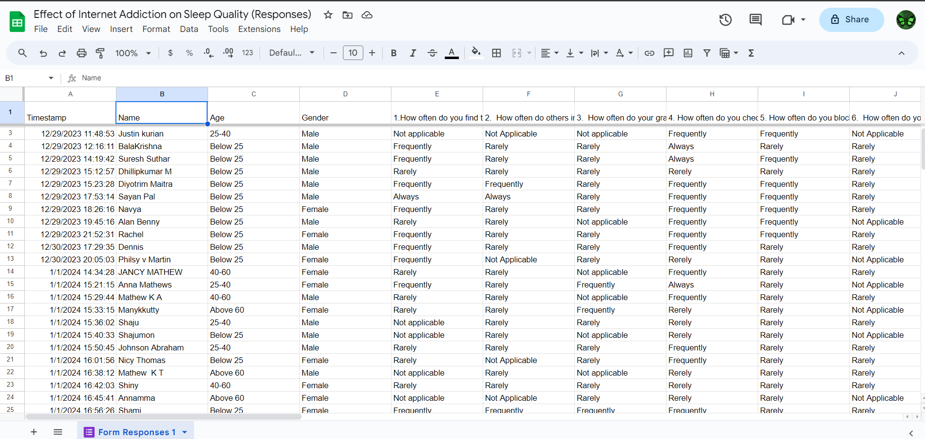
Responses

Slide 7
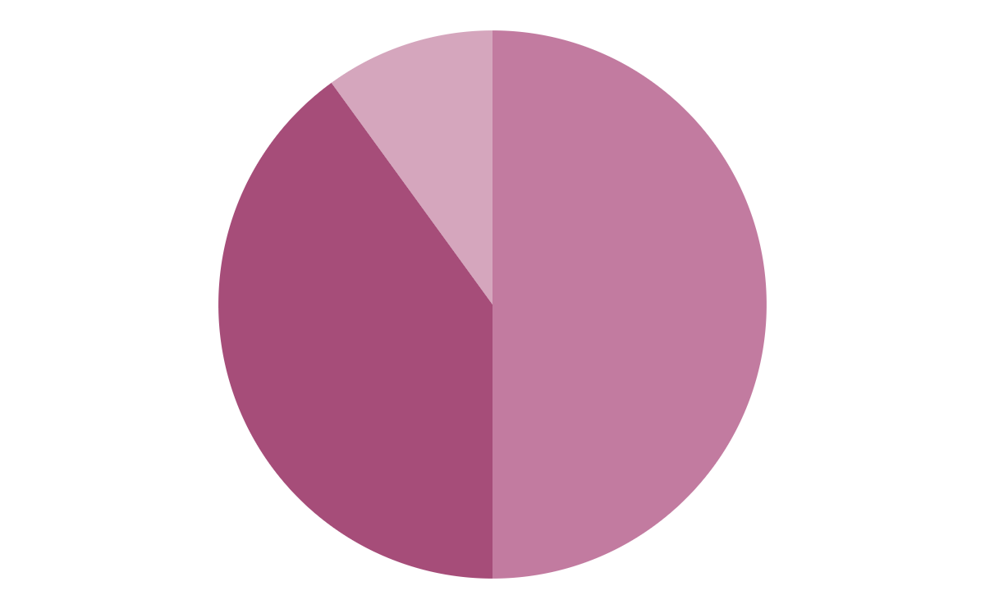

Numerical Observations
69.5%
30.5%
Females
Males
282
Respondents

Slide 8

METHODOLOGY

Slide 9
COLLECTION OF DATA: The data is collected through questionnaires consisting of carefully created 18 questions relating to internet usage and sleep patterns of different individuals. The two tests conducted prior to the analysis are Internet Addiction Test (IAT) and Pittsburgh Sleep Quality Index (PSQI).
Internet Addiction Test
(IAT)
(IAT) evaluates the level of internet addiction of a person. Options for each question are scored from 0-3. In each question, 0 indicates the least internet addiction symptoms and 3 indicates the most. Each person’s IAT score will be a sum of 0, 1, 2 or 3 corresponding to their answers. The IAT scores found out of total score 33 (variable 𝑥) are then converted to percentages. These are categorized as follows:
Pittsburgh Sleep Quality Index
(PSQI)
PSQI) test evaluates the sleep quality of a person during a month. The sample population is given options 0-3 for each question. In each question 0 indicates best conditions for good sleep qualities and 3 indicates poor sleep qualities. Each person’s PSQI score (variable y) is the sum of the 0, 1, 2 or 3 corresponding to their answers. The PSQI scores are then categorized as follows:
0-30% -Normal
30-50% - Mild
50-80% - Moderate
80-100% - Severe
0-7 Good Sleep
8-14 Medium Sleep
15-21 Bad Sleep

Slide 10
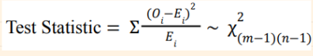
1.Chi Square Test
To analyze the relationship between internet addiction and sleep quality in the population using Chi-square test
From the above two categorizations of internet addiction and sleep quality, we can easily find the number of people having both normal addiction and good sleep, normal addiction and medium sleep, normal addiction and bad sleep, mild addiction and good sleep and so on. This way the observed values (O) of the contingency table to do the chi-square test is obtained. We are aiming to test the independence of variables, 𝑥 and 𝑦 i.e., internet addiction and sleep quality.
Null hypothesis 𝐻0 : Internet Addiction and Sleep Quality are independent
Alternate hypothesis 𝐻1 : Internet Addiction and Sleep Quality are not independent
Where 0i is the observed frequency and Ei is the expected Frequency. m is the number of rows and n the number of columns.(m-1)(n-1) is the required degrees of freedom

Slide 11
To check the dependence of age and internet addiction using Chi Square Test From the questionnaire, we can find the age . Using Internet addiction test, we had obtained the Addiction levels. They are the variables for this chi square test. This way the observed values (O) of the contingency table to do the chi-square test is obtained. We are aiming to test the independence of variables age and Internet Addiction Null hypothesis 𝐻0 : Internet Addiction and Age are independent Alternate hypothesis 𝐻1 : Internet Addiction and Age are not independent
To check the dependence of gender and sleep quality using Chi square Test
From the questionnaire, we can find the gender . Using Pittsburgh Sleep quality Index, we had obtained the levels of sleep quality. They are the variables for this chi square test. This way the observed values (O) of the contingency table to do the chi-square test is obtained. We are aiming to test the independence of variables gender and Sleep quality
Null hypothesis 𝐻0 : Gender and Sleep Quality are independent
Alternate hypothesis 𝐻1 : Gender and Sleep Quality are not independent

Slide 12
2. ANOVA Test
One-way Analysis of Variance (ANOVA) is a statistical method used to assess whether there are any statistically significant differences in the means of three or more independent (unrelated) groups. It compares the variability within each group to the variability between the groups to determine if there is evidence that at least one group mean is different from the others. The factor considered here is age groups .
ASSUMPTIONS:
Independence:
Observations within each group must be independent.
Normality:
The populations from which the groups are drawn should follow a normal distribution. However, ANOVA is robust to violations of normality, especially with larger sample sizes.
Homogeneity of Variances:
The variances within each group should be approximately equal. This assumption is important for the validity of the F-test.
Null Hypothesis (H0​):
there are no significant differences in the means in sleep hours of the age groups.
Alternative Hypothesis (H1​):
there is significant differences in the means in sleep hours of the age groups.

Slide 13
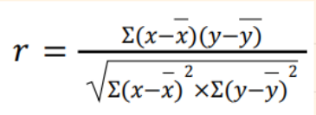
3. Correlation Test
The correlation coefficient (𝑟) can range in value from −1 to +1. The larger the absolute value of the coefficient, the stronger the relationship between the variables i. e., internet addiction and sleep quality index. Variable 𝑥 represents internet addiction and variable 𝑦 represents the PSQI scores for sleep quality.
Then, correlation coefficient 𝑟 is calculated using the following formula:

Slide 14
ANALYSIS

Slide 15
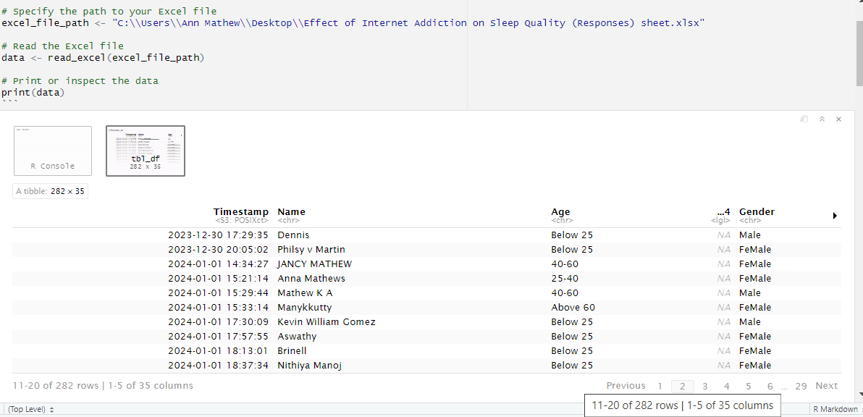
IMPORTING EXCEL FILE TO R

Slide 16
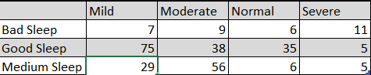
1.To check if Internet addiction and Sleep Quality are dependent using Chi Square Test
Null hypothesis 𝐻0 : Internet Addiction and Sleep Quality are independent
Alternate hypothesis 𝐻1 : Internet Addiction and Sleep Quality are not independent
CONTINGENCY TABLE

Slide 17
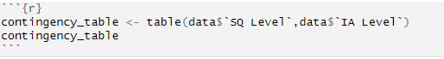
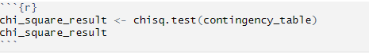
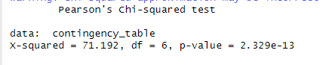
R- CODE
INFERENCE:
Since p value is less than 0.05, we reject the null hypothesis at 5 % level of significance and conclude that internet addiction and sleep quality are dependent on each other.

Slide 18
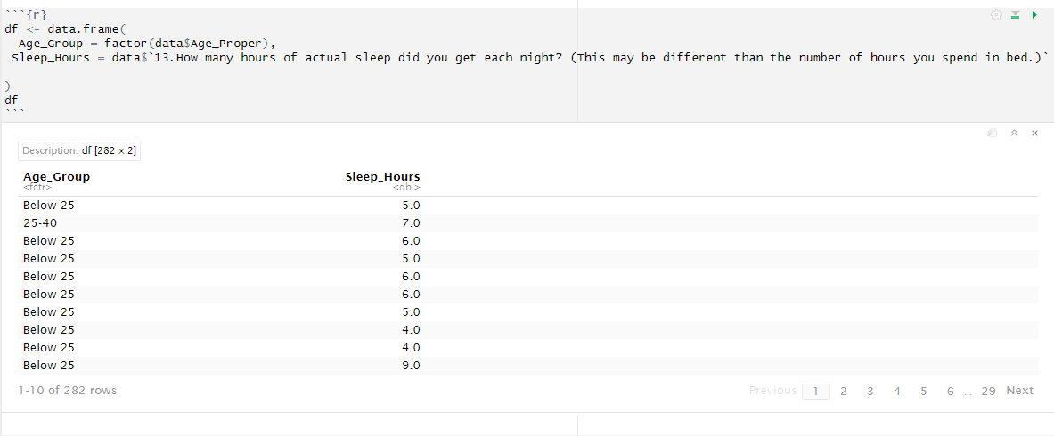
2. ANOVA test to check if there is a significant difference in sleep hours among age groups
Null Hypothesis (H0​):
there are no significant differences in the means in sleep hours of the age groups.
Alternative Hypothesis (H1​):
there is a significant difference in the means in sleep hours of the age groups.
Creating a dataframe:

Slide 19
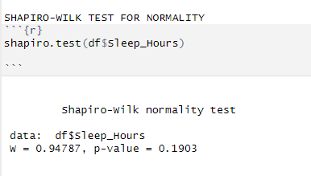
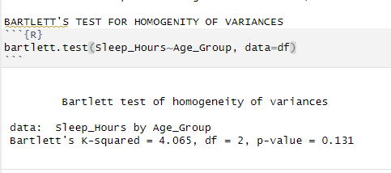
Checking Assumptions
Shapiro-wilk Test for Normality of Data
H0​:The sample comes from a normally distributed population
H1​:The sample does not come from a normally distributed population.
Inference: P- value is greater than 0.05, hence we accept the null
Hypothesis that the sample comes from a normal population.
Bartlett’s Test for Homogenity of Variances:
H0​:All group variances are equal
H1​:At least one group has a different variance
Inference: Since the p-value=0.131 is greater than 0.05, we fail
to reject the null hypothesis and conclude that the
group variances are equal. We since the assumption
that the data is normal and the homogenity of
variances is satisified, we perform ANOVA test.

Slide 20
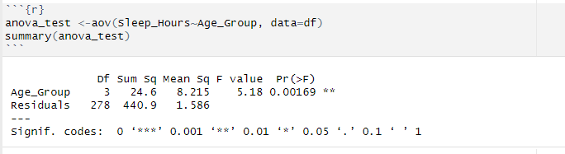
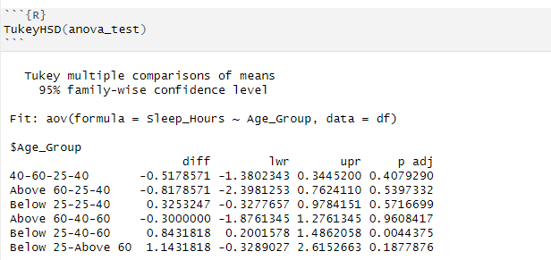
ANOVA TEST
Inference: Since the p- value is less
than 0.05, we reject the null hypothesis
and conclude that there is a significant
differences in the means in sleep hours of the
age groups.
POST-HOC TEST
We conclude that there is a significant difference in mean sleep hours between age groups below 25 and that between 40-60 since p – value is less than 0.05.

Slide 21
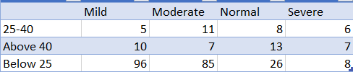
3. To check the dependence of age and internet addiction using chi square test
Null hypothesis 𝐻0 : Internet Addiction and Age are independent Alternate hypothesis 𝐻1 : Internet Addiction and Age are not independent
CONTINGENCY TABLE

Slide 22
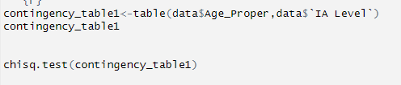
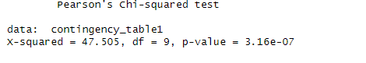
R-CODE
Inference:
Since p value is less than 0.05, we reject the null hypothesis at 5 % level of significance and conclude that internet addiction and age are dependent on each other.

Slide 23
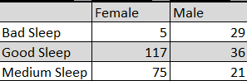
4. To check the dependence of gender and sleep quality using Chi square Test
Null hypothesis 𝐻0 : Gender and Sleep Quality are independent
Alternate hypothesis 𝐻1 : Gender and Sleep Quality are not independent
CONTINGENCY TABLE

Slide 24
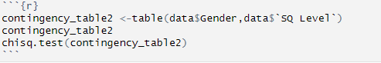
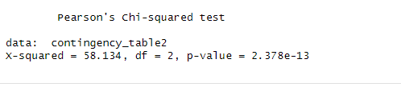
R-CODE
Inference:
Since p value is less than 0.05, we reject the null hypothesis at 5 % level of significance and conclude that Gender and sleep quality are dependent on each other

Slide 25
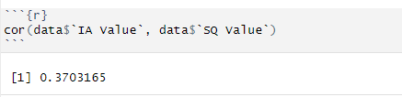
5.To check the correlation between internet addiction and problems in sleep quality
R-CODE
Inference: This result indicates that there is a positive (weak) correlation between internet addiction and problems in sleep quality.

Slide 26
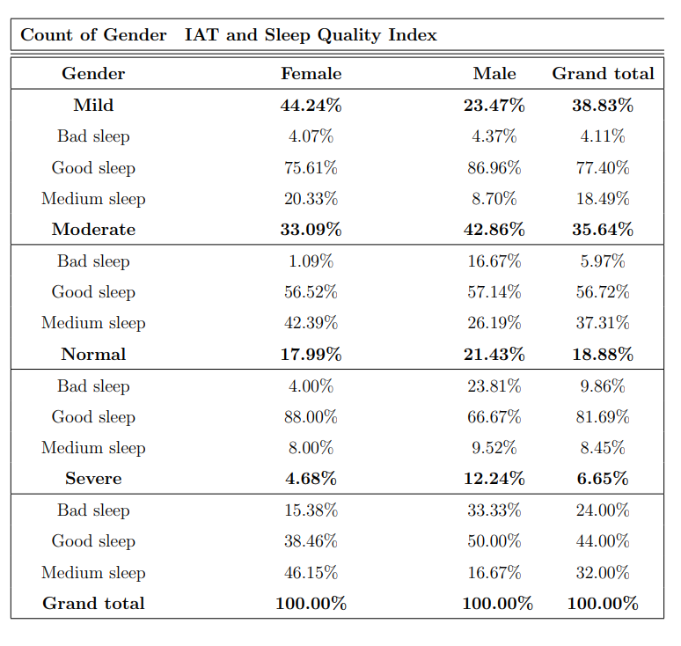
A comparison of males and females with different internet addiction levels and sleep qualities using multiple bar graph

Slide 27
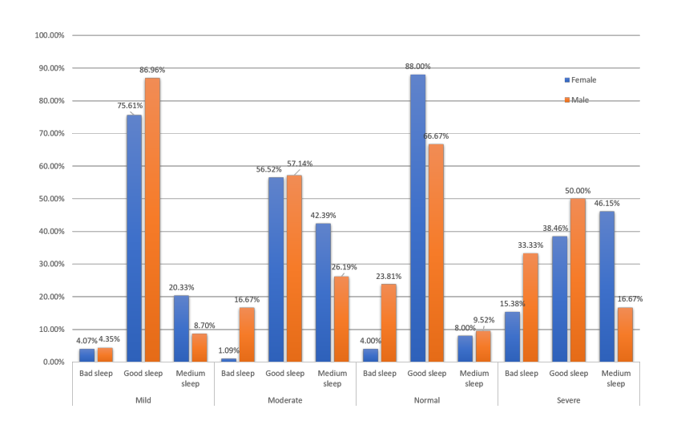

Slide 28
RESULTS
OBJECTIVE 1
OBJECTIVE 2
OBJECTIVE 3
Since p value is less than 0.05, we reject the null hypothesis at 5 % level of significance and conclude that internet addiction and sleep quality are dependent on each other
We conclude that there is a significant difference in mean sleep hours between age groups below 25 and that between 40-60 since p – value is less than 0.05.
Since p value is less than 0.05, we reject the null hypothesis at 5 % level of significance and conclude that internet addiction and age are dependent on each other.

Slide 29
RESULTS
OBJECTIVE 4
OBJECTIVE 5
Since p value is less than 0.05, we reject the null hypothesis at 5 % level of significance and conclude that Gender and sleep quality are dependent on each other
There is a positive (weak) correlation between internet addiction and problems in sleep quality.

Slide 30
CONCLUSION
According to the graph, it can be seen that more than 50% of males get good sleep in all levels of internet addiction whereas sleep quality of females are more likely to be affected by different levels of internet addiction.
From the above graph, it is seen that females are having a significant impact on their sleep quality compared to that of males with respect to their internet addiction level. Thus it was concluded that more female participants had a deteriorating sleep quality due to excessive internet usage.
This study and analysis were seen to be more effective for teens and young adults as they are well-versed with scientific technology and electronic gadgets when compared to adults and senior citizens.
Also, the above results show that internet addiction and sleep quality are positively correlated and are significant in a population.
It was seen that internet addiction and age are dependent. It was also seen that the genders and sleep quality are dependent.
Thus, evidently, Excessive use of the internet is associated with reduced sleep quality and increased day time sleepiness. High internet addiction causes less sleep quality.

Slide 31

FUTURE PROSPECTS
Future studies could explore the long-term effects of internet addiction on sleep quality. Investigating how persistent internet addiction contributes to chronic sleep disturbances and associated health issues would provide valuable insights.
Researchers may delve into identifying moderating factors that influence the relationship between internet addiction and sleep quality. Factors such as age, gender, cultural differences, and individual coping mechanisms could be explored to understand their role in this association.
Investigating the broader impact of internet addiction on mental health, including conditions such as anxiety and depression, could be an avenue for future research.
Advancements in neurobiological research could contribute to a deeper understanding of the mechanisms through which internet addiction affects sleep patterns. This may involve exploring brain changes, neurotransmitter activity, and the impact on circadian rhythms.
Collaborations between researchers and technology developers could lead to the creation of applications or features that help users manage their online time responsibly, promoting better sleep hygiene. This could include features that remind users to take breaks, limit screen time before bedtime, or promote a healthy digital balance.

Slide 32

SUGGESTIONS
Awareness Programmes
More studies should be done
Intervention Programmes
Limit Internet Usage
Remove social network apps
Do not take cell phone to bed

Slide 33
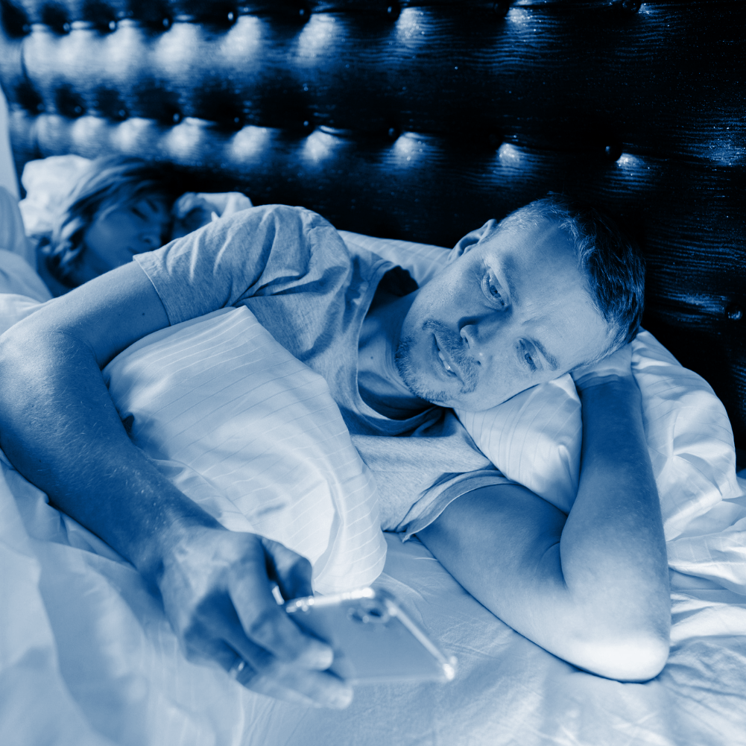
THANK YOU

